Slide 1
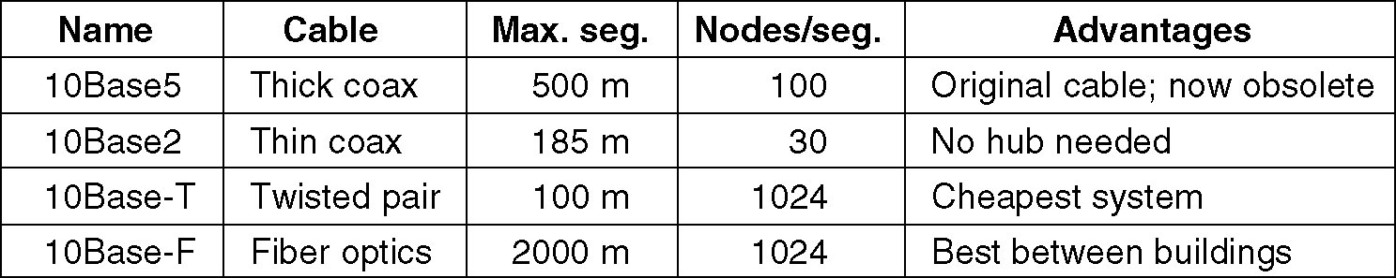
Ethernet Cabling

Slide 2
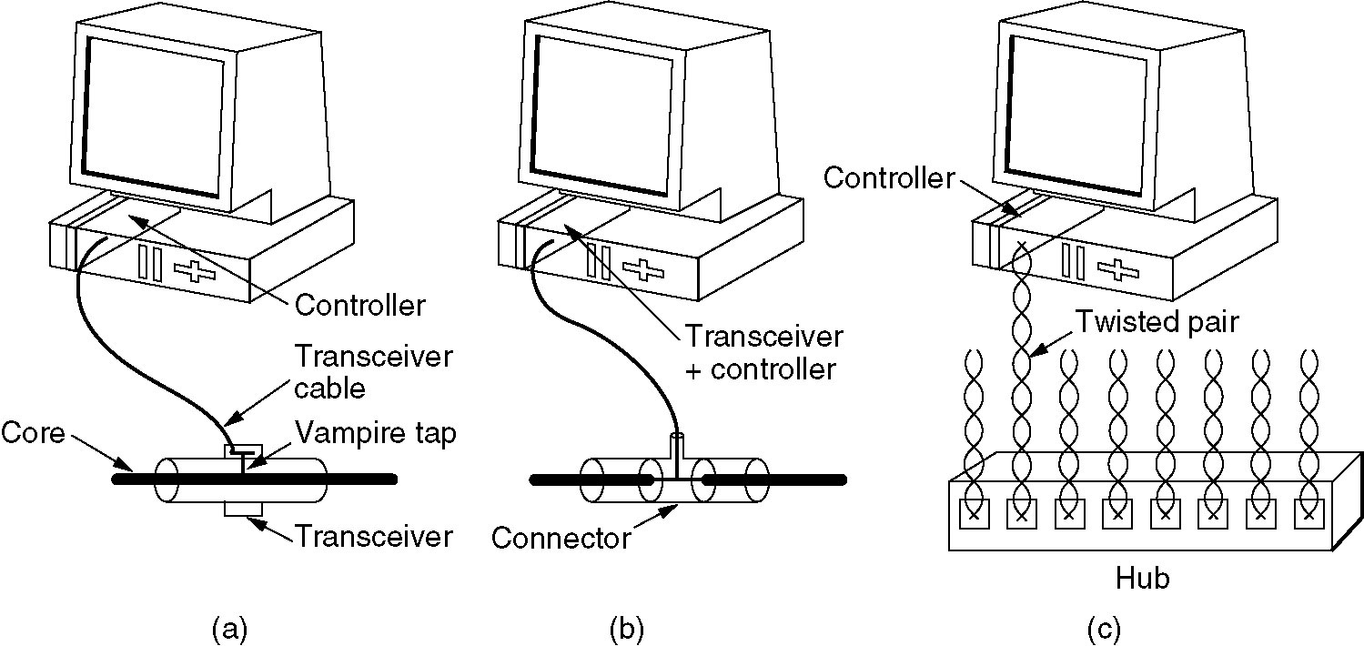
Ethernet Cabling
Three kinds of Ethernet cabling.
(a) 10Base5, (b) 10Base2, (c) 10Base-T.

Slide 3
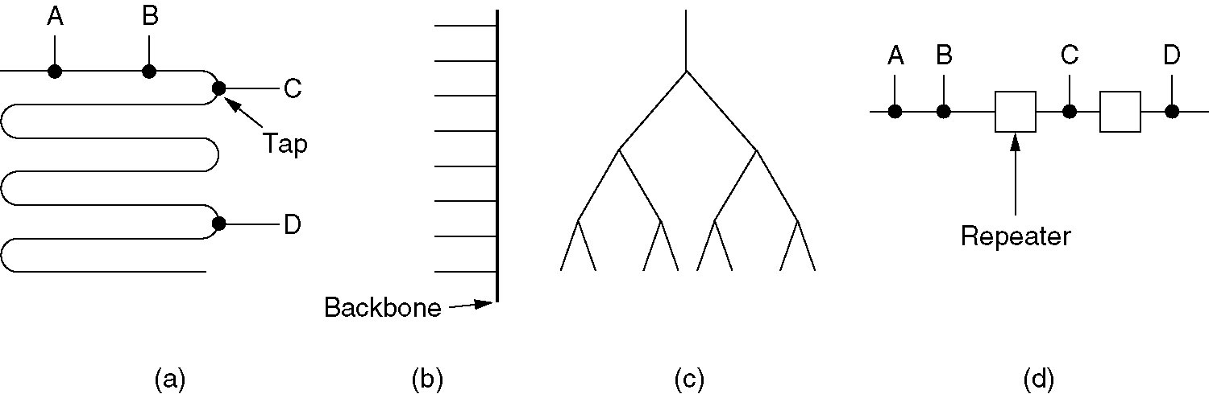
Ethernet Cabling
Cable topologies. (a) Linear, (b) Spine, (c) Tree, (d) Segmented.

Slide 4
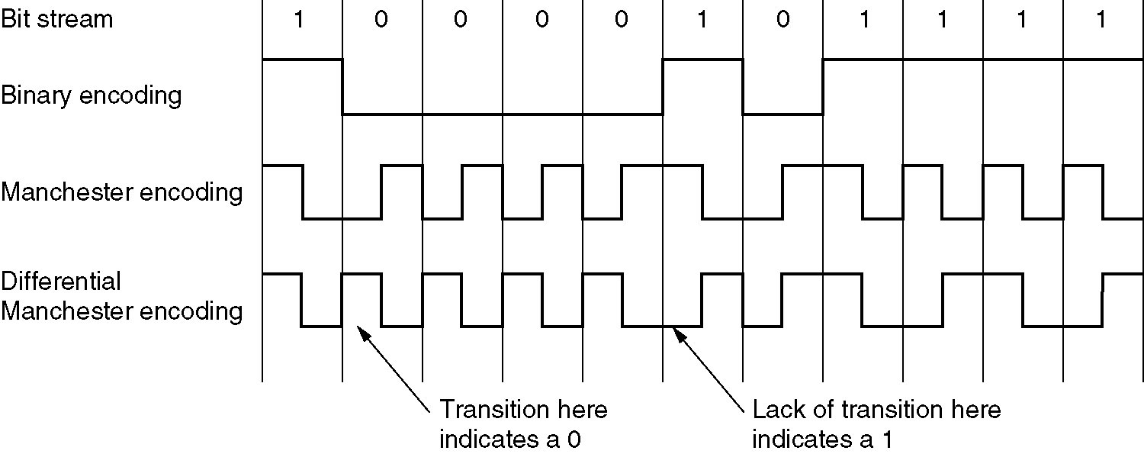
Manchester Encoding
(a) Binary encoding, (b) Manchester encoding,
(c) Differential Manchester encoding.

Slide 5
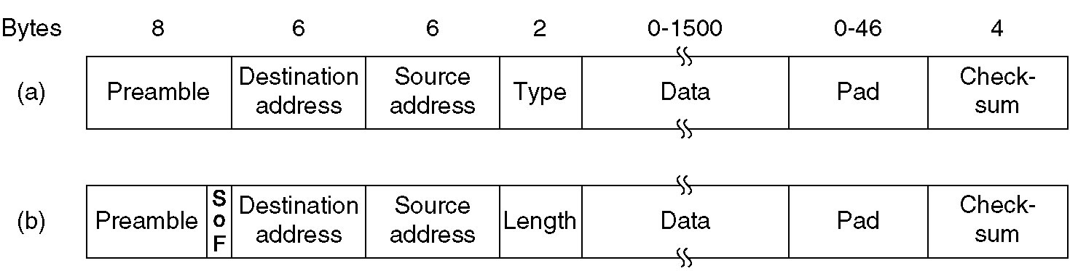
DIX Ethernet and IEEE 802.3 Frame Structures
Frame formats. (a) DIX Ethernet, (b) IEEE 802.3.

Slide 6
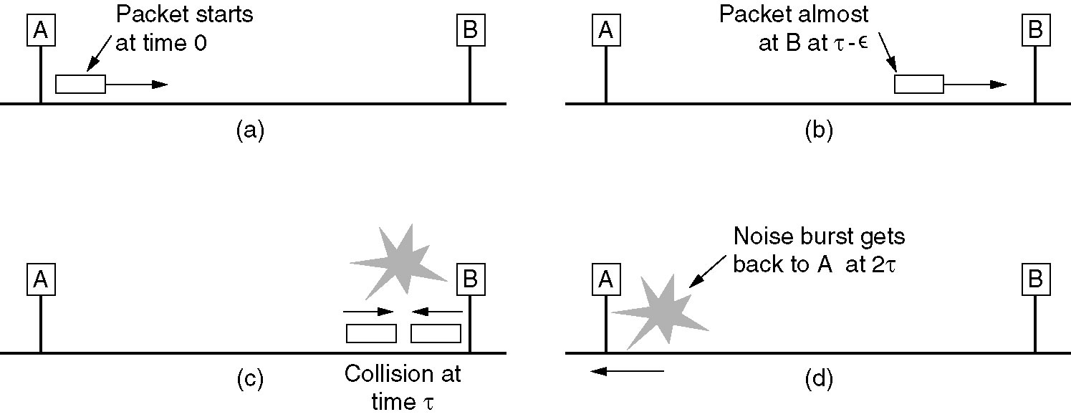
Minimum DIX Frame Size Rationale

